Slide 1

Prepared by:
Mahmoud Ehab Mahmoud Abdeen.
Ahmed Khaled Mohana Tohamy.
Mariam Mohamed Abdelmonem Ismail.
Under supervision of
DR/Manal showman

Slide 2
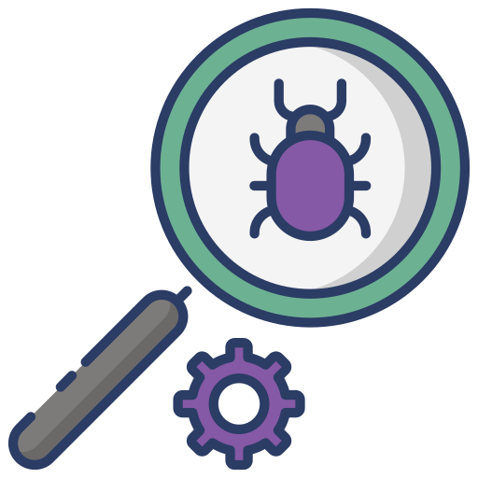



Aim
Modules
Non-fun.
Log out

Slide 3
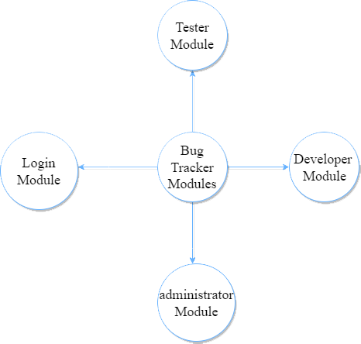
purpose of the software is to track bugs and allow the end user to manage bugs and store them if they ever appear in other projects.

Slide 4
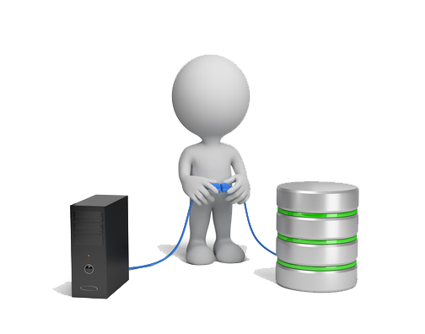


Intro page
Administrator
Login page
Tester
Developer

Slide 5
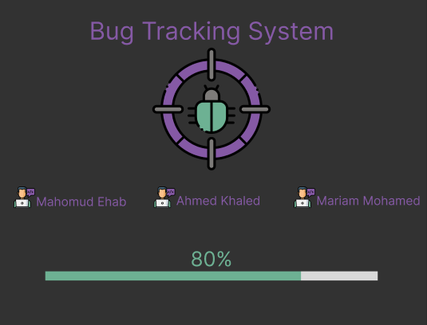
Intro page

Slide 6
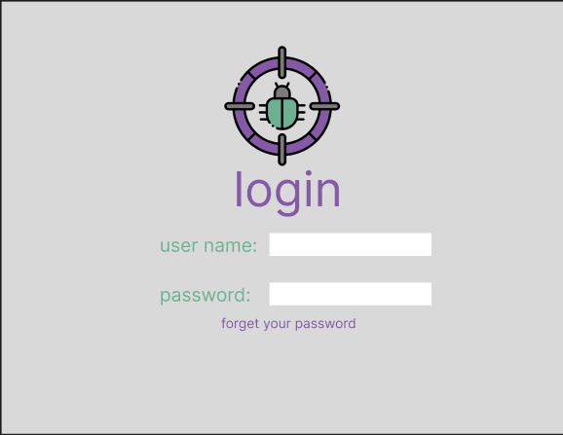
Login page
The gateway to user profiles.
Prevents unauthorized access.
Notifies the administrator when a password reset is needed.

Slide 7
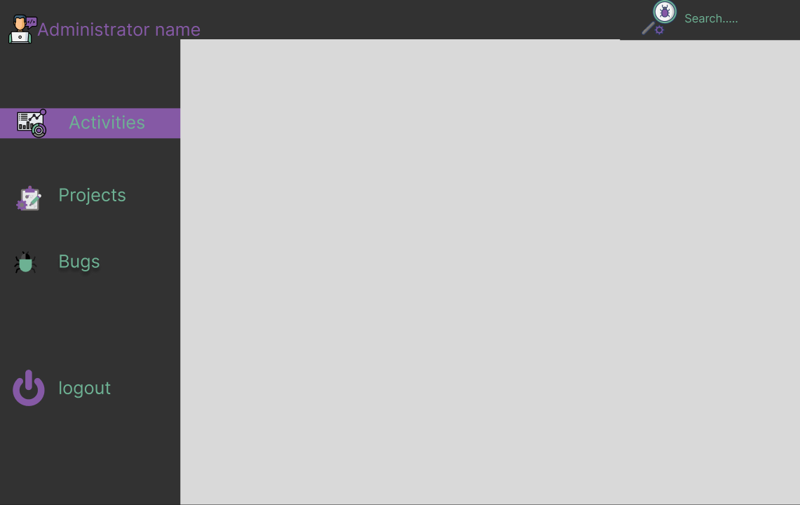
Administrator
Monitors and maintains the system.
Adds new users.
Edits and deletes user information.
Creates projects.
Updates and terminates projects.
Adds bug information.

Slide 8
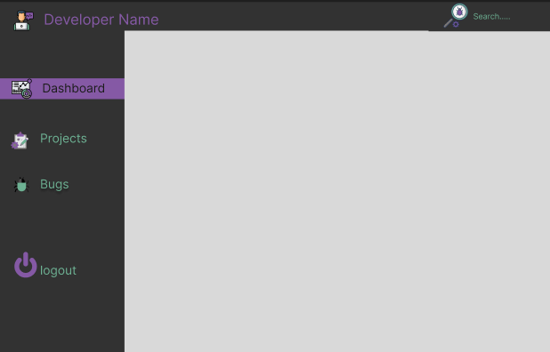
Developer
Responsible for solving bugs.
Views assigned projects.
Updates assigned bugs status.
Changes profile password.

Slide 9
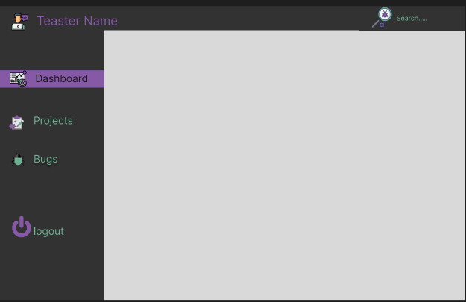
Tester
Responsible for discovering bugs.
Views assigned projects.
Adds bug reports to the system.
Checks added bugs status.

Slide 10
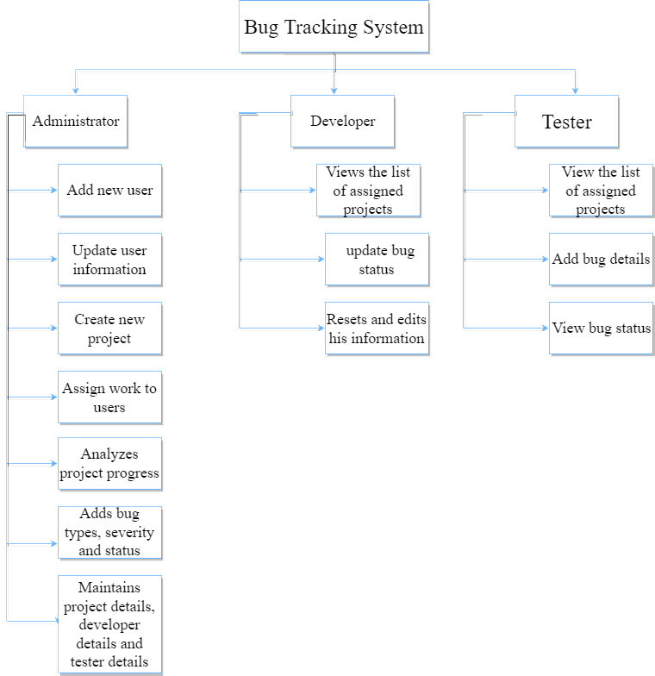
Abstract

Slide 11
Non-fun.
Availability:
The system should be available during working hours.
Maintainability:
The system consists of modules every module consists of classes in order, so the system is easy to maintainable.
Security:
No one can access the system from outside the faculty.
Portability:
The system is a desktop application can run on several operating systems.
Usability:
The system is usable for all users (developers & testers).
Efficiency:
The system is efficient in a lot of software companies because it solves the bugs of the software.

Slide 12


